Slide 1






Foundations of
Quantum Information Science (QIS 102)
Dave Biersach
Brookhaven National Laboratory
dbiersach@bnl.gov
Session 05
Algorithmic
Efficiency

Slide 2
Session 05 – Topics
Appreciate how to encode and decode objects as numbers
Learn about Python Sequences, including Lists and Arrays
Correlate index numbers and addressable elements
Represent anonymous variables with a single underscore
Measure (instrument) code performance using Python's built-in high-precision timers
Review run-time complexity and big-O notation
Leverage handy algorithms already implemented in Numpy

Slide 3
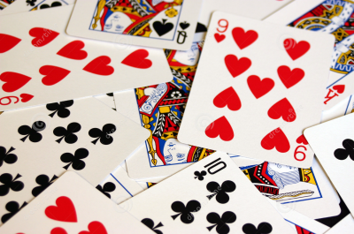
Encoding (Representation)
Cards in a deck are numbered 0 – 51
Card Suit |  |  | Card Rank
0 | Clubs |  | 0 | Deuce
1 | Diamonds |  | 1 | Three
2 | Hearts |  | 2 | Four
3 | Spades |  | 3 | Five
 |  |  | 4 | Six
 |  |  | 5 | Seven
 |  |  | 6 | Eight
 |  |  | 7 | Nine
 |  |  | 8 | Ten
 |  |  | 9 | Jack
 |  |  | 10 | Queen
 |  |  | 11 | King
 |  |  | 12 | Ace
How can we convert to & from a card # and a specific suit and rank?

Slide 4
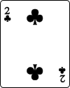
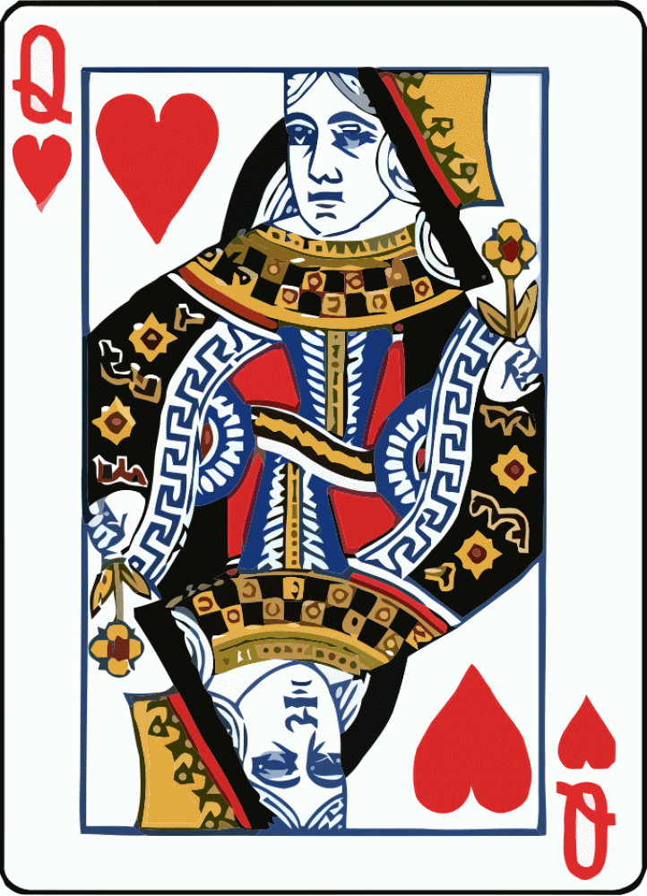
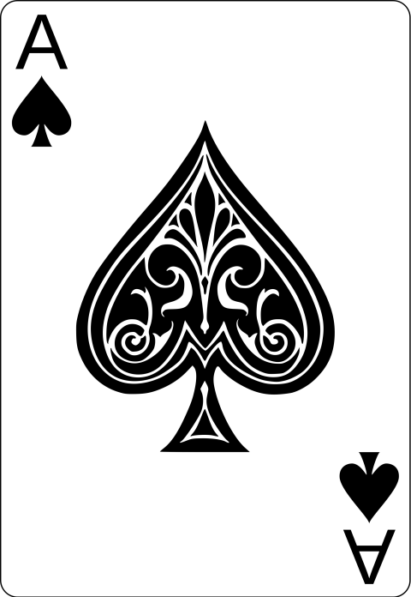
Encoding (Representation)
Cards in a deck are numbered 0 – 51
Card # = Suit * 13 + Rank
Card Suit |  |  | Card Rank
0 | Clubs |  | 0 | Deuce
1 | Diamonds |  | 1 | Three
2 | Hearts |  | 2 | Four
3 | Spades |  | 3 | Five
 |  |  | 4 | Six
 |  |  | 5 | Seven
 |  |  | 6 | Eight
 |  |  | 7 | Nine
 |  |  | 8 | Ten
 |  |  | 9 | Jack
 |  |  | 10 | Queen
 |  |  | 11 | King
 |  |  | 12 | Ace
Suit = 0
Rank = 0
0 * 13 + 0 = 0
Suit = 2
Rank = 10
2 * 13 + 10 = 36
Suit = 3
Rank = 12
3 * 13 + 12 = 51

Slide 5
Decoding (Representation)
Cards in a deck are numbered 0 – 51
Suit = (Card #) // 13
Rank = (Card #) % 13
Card Suit |  |  | Card Rank
0 | Clubs |  | 0 | Deuce
1 | Diamonds |  | 1 | Three
2 | Hearts |  | 2 | Four
3 | Spades |  | 3 | Five
 |  |  | 4 | Six
 |  |  | 5 | Seven
 |  |  | 6 | Eight
 |  |  | 7 | Nine
 |  |  | 8 | Ten
 |  |  | 9 | Jack
 |  |  | 10 | Queen
 |  |  | 11 | King
 |  |  | 12 | Ace
// returns the integer quotient
39 // 7 = 5
% is the modulus (remainder)
39 % 7 = 4

Slide 6
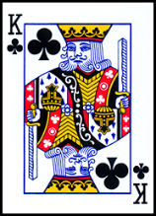
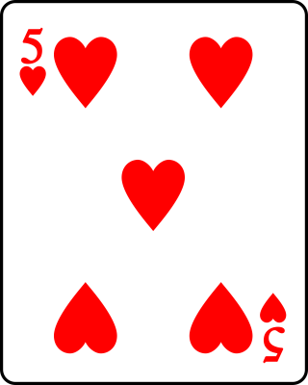
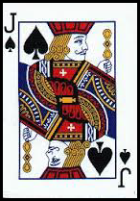
Decoding (Representation)
Cards in a deck are numbered 0 – 51
Suit = (Card #) // 13
Rank = (Card #) % 13
Card Suit |  |  | Card Rank
0 | Clubs |  | 0 | Deuce
1 | Diamonds |  | 1 | Three
2 | Hearts |  | 2 | Four
3 | Spades |  | 3 | Five
 |  |  | 4 | Six
 |  |  | 5 | Seven
 |  |  | 6 | Eight
 |  |  | 7 | Nine
 |  |  | 8 | Ten
 |  |  | 9 | Jack
 |  |  | 10 | Queen
 |  |  | 11 | King
 |  |  | 12 | Ace
Card # = 11
Suit = 11 // 13 = 0
Rank = 11 % 13 = 11
Card # = 29
Suit = 29 // 13 = 2
Rank = 29 % 13 = 3
Card # = 48
Suit = 48 // 13 = 3
Rank = 48 % 13 = 9

Slide 7
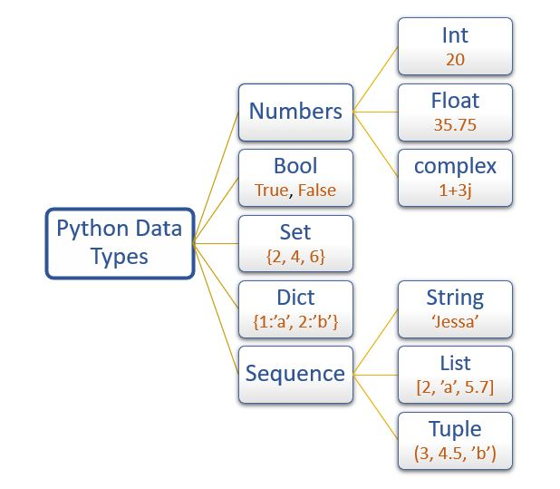
Python Built-In Data Types
Sequence types support indexed [] access
NOTE: You can use enumerate() with these data types

Slide 8
Python Lists
A list is a set of elements that can have varying types
Individual elements in a list are accessed by using their index number within square [] brackets
Every element has a unique index number
No two elements share the exact same index number
The first element has an index = 0
The function len() returns the length of a list, which is the number of element in list
The last addressable element in a list is [len() – 1] – why?

Slide 9
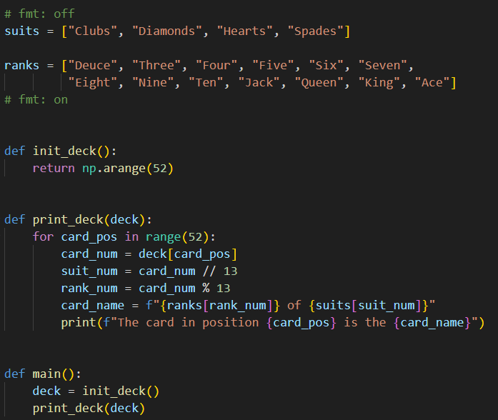
Open list_cards.py
①
②
③
⑤
⑥
⑧
⑨
⑩
11
12
④
⑦

Slide 10
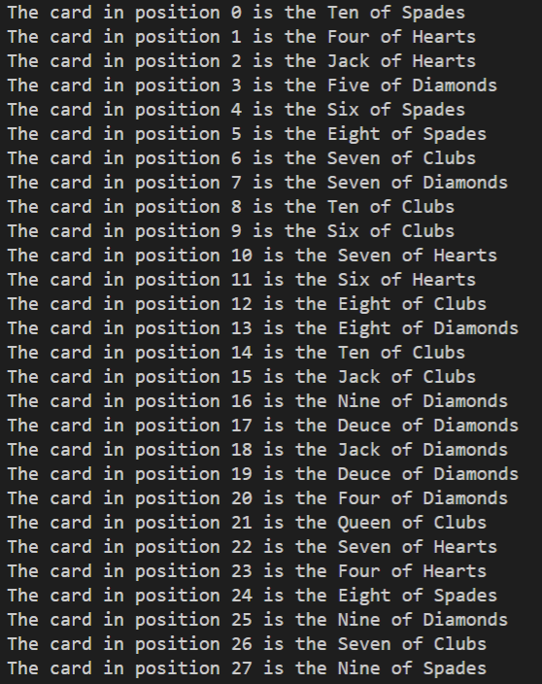
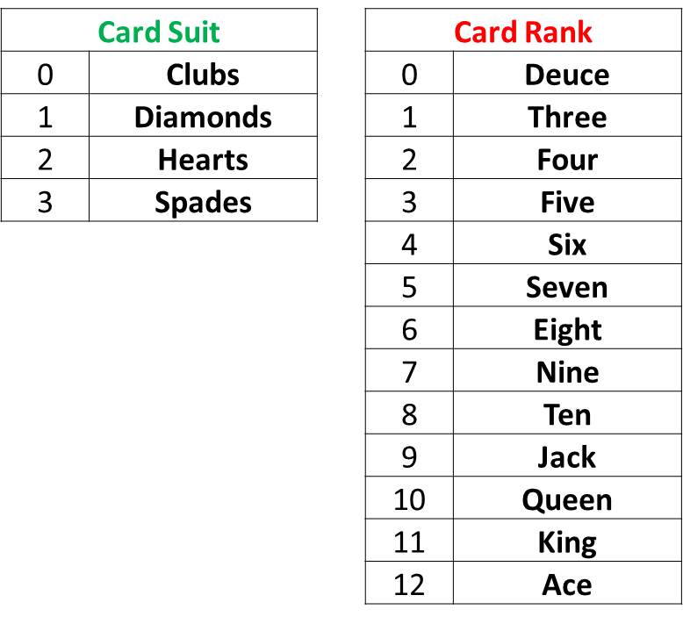
Run list_cards.py

Slide 11
Initializing a Random Deck
We now want to generate a random deck that should not be in order
We should range through each item in the deck[] array from the first card position to the last card position
We want to pick a random card number to insert into each position number

Slide 12
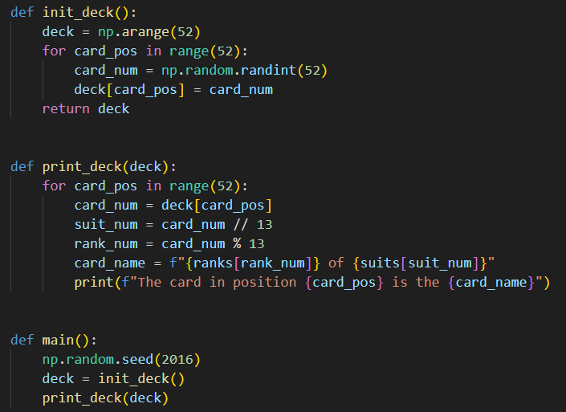
Open dealer_bogus.py
③
④
⑤
⑥
⑦
⑨
⑩
①
②
⑧

Slide 13
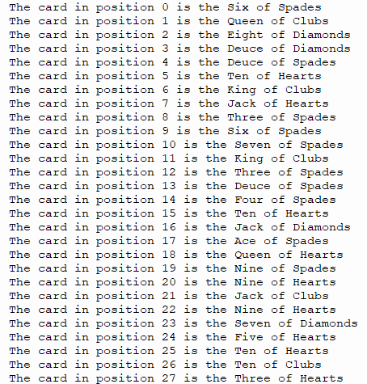
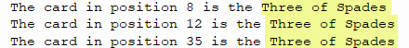
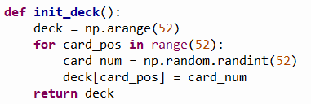
Run dealer_bogus.py
☹

Slide 14
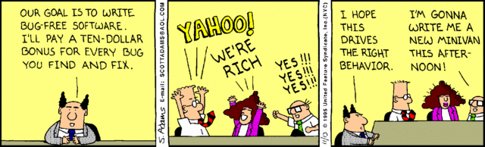
Random… but no repeats?
How can we get a set of random numbers where no number is repeated until all numbers are picked at least once?
Can we flag that a particular card # has already been dealt, and therefore not deal that card again?

Slide 15
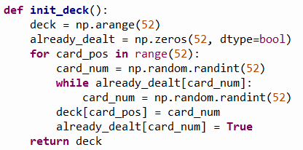
Open dealer_slow.py
We need a helper array to store a True or False flag to record if a random trial card number has already been dealt.
Then we need to keep picking random trial card numbers until a card number is found that has yet to be dealt. When that card is found, we update the helper array to record that card number has been dealt so it cannot be picked again.
①
②
③
④
⑤
⑥
⑦
⑧
⑨
⑩

Slide 16
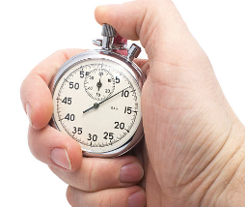
Instrumenting Your Code
Instrumenting code is the process of taking accurate timings of the runtime performance of key algorithms within the program
Python provides a time object that can measure the current CPU time of a running process to the nearest millisecond (1/1000th of a second) which is sufficient in most situations
We bracket the code under analysis by measuring the clock immediately before the start and again after the end of the algorithm to calculate the elapsed time
Careful tracking of code timings will provide objective empirical evidence if changes to algorithms and/or data structures are indeed making the program more efficient

Slide 17
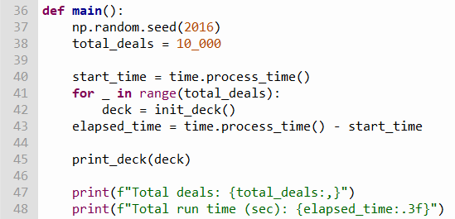
View dealer_slow.py
Write code to time how long it takes to correctly initialize 10,000 decks
①
②
③
④
⑤
⑥
⑦

Slide 18
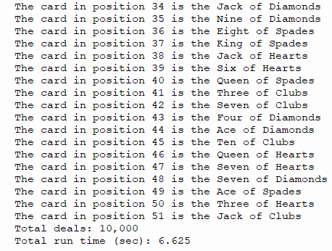
Run dealer_slow.py
No repeated cards!
☺

Slide 19
Correct but inefficient…
dealer_bogus.py
dealer_slow.py

Slide 20
A Faster Card Dealer
There is an inherent inefficiency in the naïve algorithm employed in the current init_deck() function
It takes longer and longer, as more cards are dealt, to randomly pick (find) a card that has not yet been dealt
We need to discover an algorithm that, while ensuring every card is dealt only once, doesn't lose time at the end of the deal searching for that one remaining card that has not yet been dealt
The improved algorithm doesn’t need an already_dealt helper array, and a 7th grader discovered it!

Slide 21
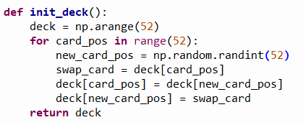
Open dealer_fast.py
Consider the revised init_deck() function:
What is going on in this function that ensures no duplicate cards are dealt and doesn't waste time trying to find the cards at the end that have not yet been dealt?

Slide 22
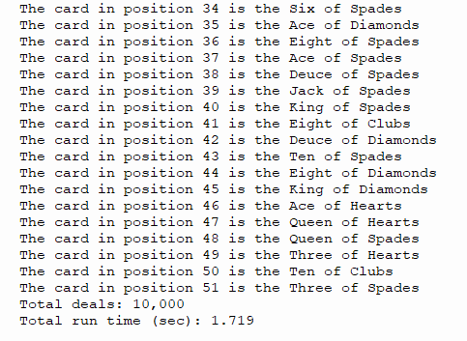
Run dealer_fast.py
No repeated cards!
☺

Slide 23
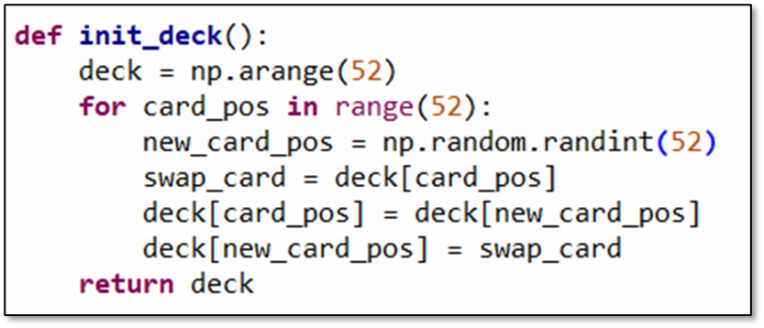
Slow vs. Fast Card Dealer
dealer_slow.py
dealer_fast.py
Fewer lines of code
No helper list needed
~4X faster
Discovered by a 7th grader

Slide 24
Computing is a New Science
The best algorithms are the ones that leave you scratching your head thinking “…that was so obvious – why didn’t I think of that?”
They are often the shortest algorithms in terms of source code length (but not always)
They are also normally the fastest algorithms to execute
For many algorithms, we have yet to discover the provably optimal approach – there is still so much unknown
Even students taking an initial computer science course can get a flash of inspiration and see something in a new way!

Slide 25
Algorithmic Efficiency
Scientific computing often involves analyzing large data sets or running large-scale simulations
It is essential to have code that runs as fast as possible while returning the correct results
We measure algorithm efficiency by estimating the impact on the total run time as the size of the input data increases
We are only interested in the principal (highest exponent) term, which describes the overall “order” of the algorithm, as we are not trying to calculate the exact run time
The order of an algorithm is expressed in “Big O” notation
The optimal algorithms have the smallest possible order

Slide 26
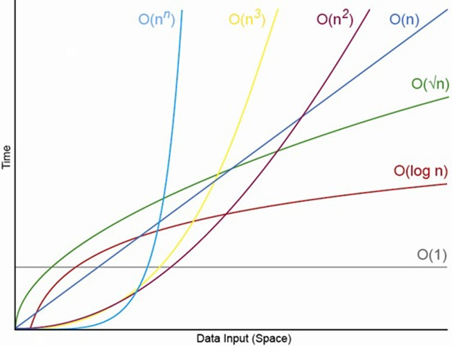
Algorithmic Efficiency
n is the # of items you must process
increasing n # of items

Slide 27
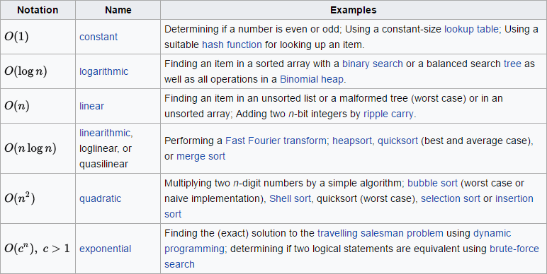
Algorithmic Efficiency

Slide 28
Prime Racer
Write a program to generate a list of 100,000 random integers in the range [1,000, 10,000]
Count the number of prime numbers within that list
Use the time.process_time() function to instrument your code and measure the total run time in seconds
As we make changes to the algorithm, we will compare the run time between each version to prove that our improvements have indeed improved the code efficiency
However, as we further optimize the program, we must continue to ensure it is still emitting the correct and consistent output

Slide 29
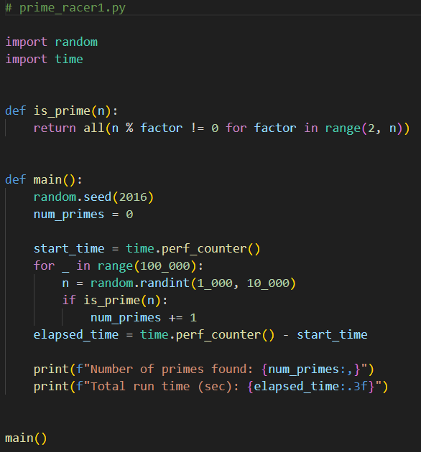
Open prime_racer1.py
⑦
①
②
③
④
⑤
⑥
⑧
⑨
⑩

Slide 30
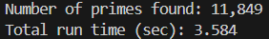
Run prime_racer1.py
①
②
What improvements could we make to reduce the work the algorithm must perform to count the number of primes?
Do we need to test all the numbers less than n?

Slide 31
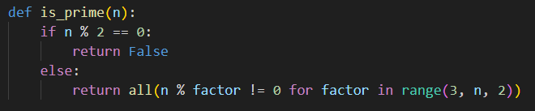
Open prime_racer2.py
①
②
③

Slide 32
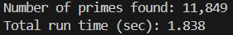
Run prime_racer2.py
①
②
Do we need to test all the odd numbers less than n?

Slide 33
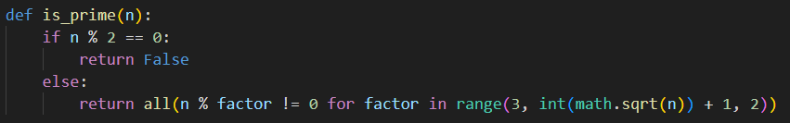
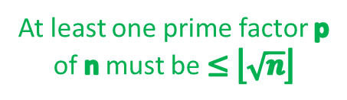
Open prime_racer3.py
At least one prime factor p of n must be $≤\left\lfloor \sqrt{n}\right\rfloor$

Slide 34
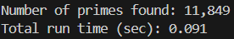
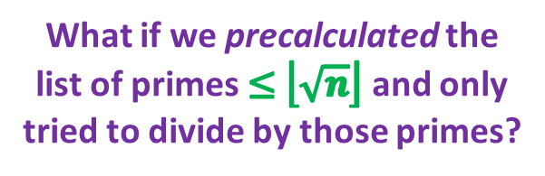
Run prime_racer3.py
①
②
What if we precalculated the list of primes $≤\left\lfloor \sqrt{n}\right\rfloor$ and only tried to divide by those primes?

Slide 35
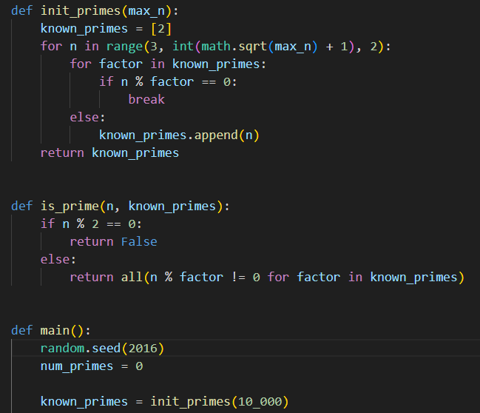
Open prime_racer4.py
②
③
④
⑤
⑥
⑦
⑧
⑨
⑩
①

Slide 36
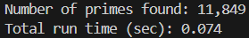
Run prime_racer4.py
①
②
Always consider if any additional code complexity is worth the performance improvement.

Slide 37
Measurable Systematic Improvement
prime_racer1.py
prime_racer2.py
prime_racer3.py
prime_racer4.py
We reduced the run time by 97% by just thinking carefully about the nature of the problem

Slide 38
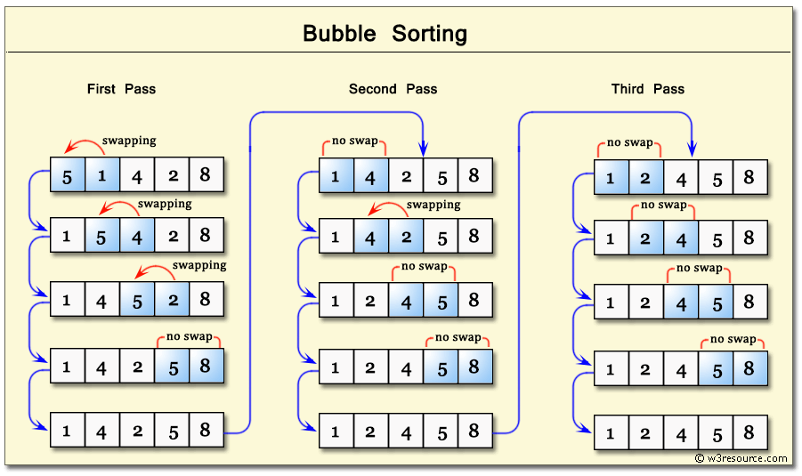
Bubble Sort

Slide 39
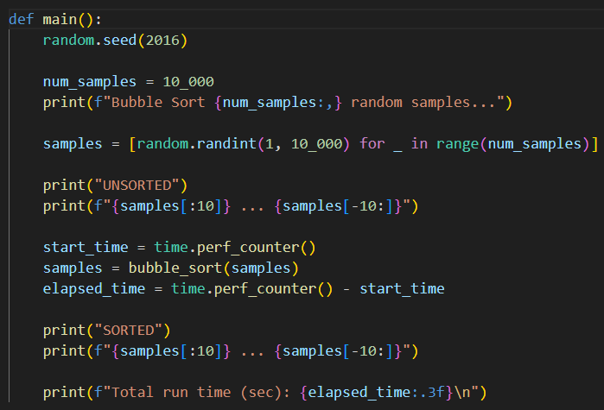
Open bubble_sort.py
①
②
③
④
[start:stop:step]
⑤
⑥
⑦
⑧
⑨
The Basics of Indexing and Slicing Python Lists

Slide 40
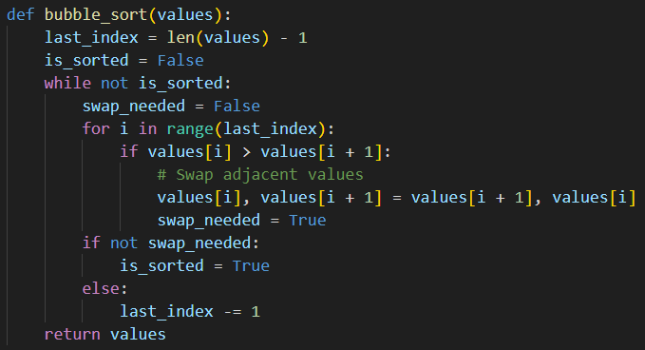
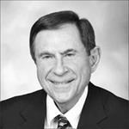
View bubble_sort.py
①
②
③
④
⑤
⑥
⑦
⑧
⑨
⑩
Invented 1956
Edward Friend
(1929-2019)

Slide 41
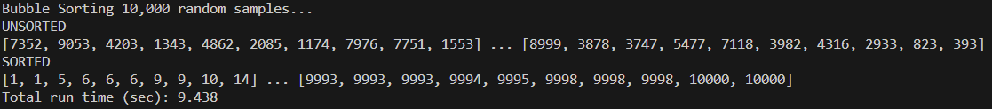
Run bubble_sort.py
①

Slide 42
The Bubble Sort Algorithm
The Bubble Sort is not very efficient because it can “move” only one element only one slot during one pass
The code spends a lot of time scanning through the array reconfirming that no swaps are needed between adjacent elements, just the same as it likely had confirmed that very fact on the previous pass through the array
It wastes time constantly rediscovering that two elements are already in the right order – this is the culprit
Wouldn’t it be better if we could move a higher test score farther to the end of the array in one big jump, rather than only a single slot each pass?
And can we stop wasting time scanning through groups of elements we have already proven to be in order?

Slide 43
The Quicksort Algorithm
Invented by Tony Hoare in 1959, Quicksort is an efficient sorting algorithm that uses a divide & conquer strategy to overcome the problems of Bubble Sort
On each pass, a portion of the array is split according to a pivot value – those elements with a value <= the pivot are swapped with those elements with a value > the pivot
This act of partitioning separates the current portion of the list into a “left” portion having smaller values than the pivot, and a “right” portion having larger values than the pivot
The left and right portions are then sorted (conquered) independently, and each portion is further split (divided) into smaller and smaller sized sub-portions, until the whole list is eventually sorted

Slide 44

The Quicksort Algorithm

Slide 45
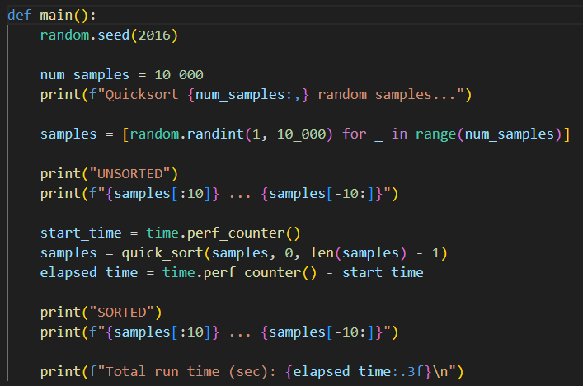
Open quicksort.py
①
②
③

Slide 46
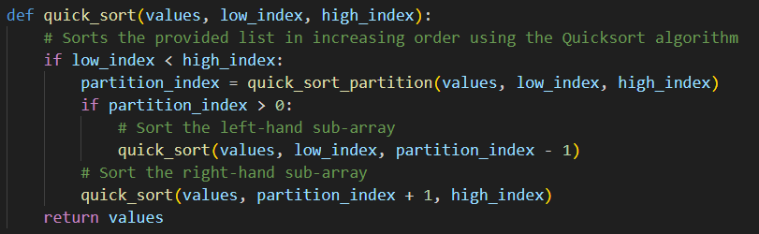
View quicksort.py
①
②
③
④
quicksort() is a recursive algorithm because it calls itself

Slide 47
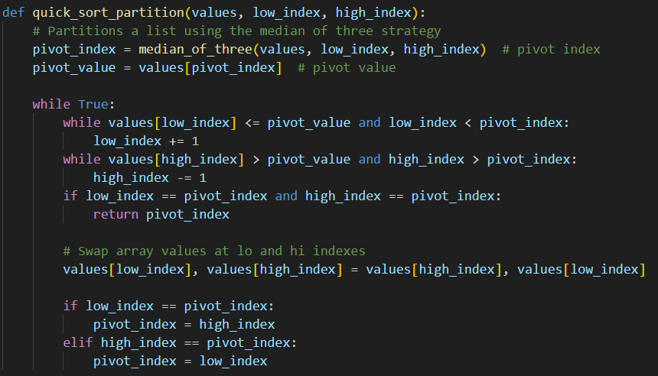
View quicksort.py
①
②
③
④

Slide 48
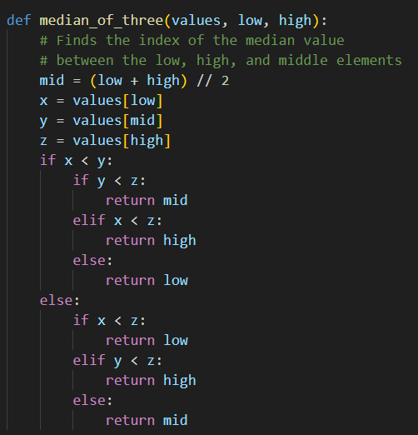
View quicksort.py
①
②
③
④

Slide 49
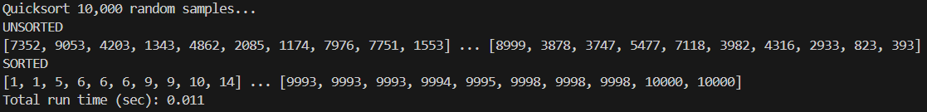
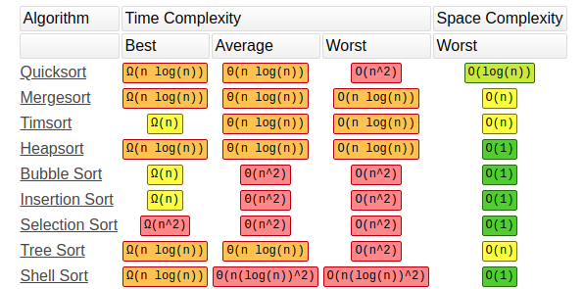
Run quicksort.py
This implementation of Quicksort is 858% faster than the Bubble Sort implementation

Slide 50
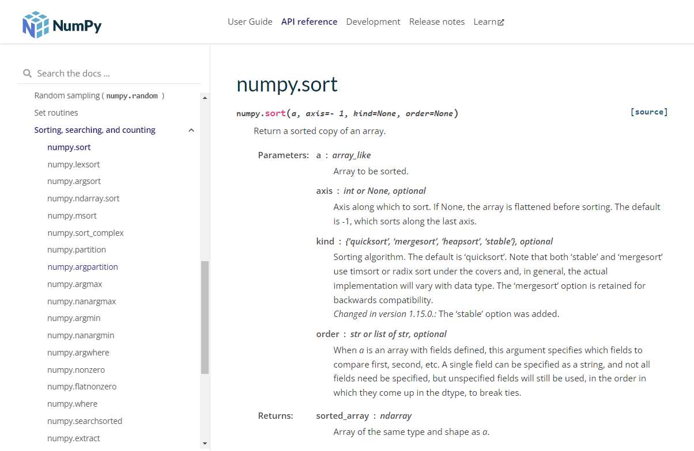
Numpy sort()

Slide 51
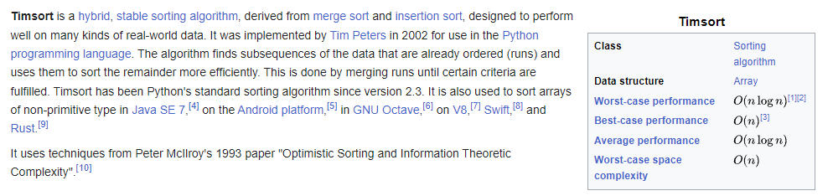
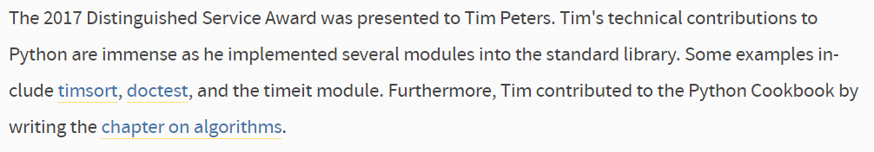
Timsort

Slide 52
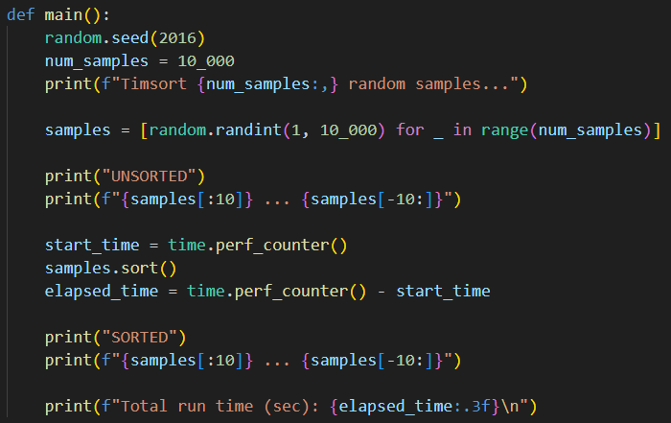
Open timsort.py
①
②
③
④
⑤
⑥
⑦
⑧
⑨
⑩

Slide 53

Run timsort.py
2002
①
1975
1956

Slide 54
Session 05 – Now You Know…
The art of computer science is finding an efficient way to represent everything as a number
Encoding needs to be unambiguous to support proper decoding
Decoding multiple things from a single number often requires the use of the modulus % operator
Lists, Strings, and Tuples are Python sequences that can be iterated
Sequences have elements that can be accessed by their unique index number inside square [] brackets

Slide 55
Session 05 – Now You Know…
The len() function returns the number of elements in the sequence
Sequence indexes are zero based - the first element is at index 0 - for example: mylist[0]
The last addressable element in a sequence is at len() - 1
Remember this phrase: "zero is a thing…zero counts"
A single underscore _ can be used as a placeholder for a "don't care" (insignificant, anonymous, temporary) variable
The swap pattern comes up very often in programming – Python makes this easy using tuple packing and unpacking

Slide 56
Session 05 – Now You Know…
We can instrument (time) code by measuring the elapsed time between when it starts and ends
Bubble Sort is easy to understand but very inefficient
Quicksort is more complex to understand but is orders of magnitude faster than Bubble Sort
From 1975 to 2002, everyone thought Quicksort was the "best" until Tim Peters invented Timsort
Look at packages like Numpy to see if they already have implemented an algorithm that you need

Slide 57
Session 05 – Now You Know…
Algorithm design remains an area of very active research, and even new programmers can make a novel contribution
New algorithms are still being discovered daily - what new algorithm will you invent to improve the world?
Quantum algorithms may offer dramatic speedup for classical algorithms that have an exponential runtime complexity

Slide 58
Task 05-01
Create a Python program called hamming_weight.py that calculates and displays the Hamming Weight of 95,601
Upload your solution to the BNL QIS102 SharePoint site

Slide 59



Task 05-02

Slide 60
Task 05-02
Fix the function check_winner() and add any other helper functions you need in the program connect_four.py
The function check_winner() should return True or False if the given player number (1 or 2) has a winning position on the given board (a list of lists)
The current code contains three lists (board1, board2, board3), with each 2D list encoding a board configuration
0 = The space is empty (neither player has a checker in that space)
1 = The space is occupied by a checker owned by Player 1
2 = The space is occupied by a checker owned by Player 2
Follow the standard rules for Connect Four to determine the winner (if there is a winner for that board)
Upload your solution to the BNL QIS102 SharePoint site

